Slide 1

McGraw-Hill Technology Education
Copyright © 2006 by The McGraw-Hill Companies, Inc. All rights reserved.

Slide 2
Chapter 2B
E-mail and Other Internet Services

Slide 3
Using E-mail
Exchanges messages with other users
  Messages reach destination in seconds
  Mail waits in mailbox until opened
  Text, audio, pictures and video messages
Notes:
Teaching tip
Have a student define spam. While most people hate spam and wish it would stop, explore the implications of anti-spam laws in a free trade society.

Slide 4
Using e-mail
Configuring e-mail
  e-mail clients read and send e-mail
  Outlook and Eudora are common
    Need name of mail server
    Need username and password
  Hotmail and Yahoo are online clients
    No configuration needed
Notes:
Teaching Tip
Suggest to your students to acquire a professional e-mail address from Hotmail or other online service. These free services usually outlast university or employer e-mail.

Slide 5
Using e-mail
e-mail addresses
  Unique address
  Allows sending and receiving
  Username@isp.com
Listserv
  Lists of e-mail addresses
  Each address gets the e-mail

Slide 6
Using e-mail
e-mail actions
  Create a new message
  Send an attachment
  Reply to e-mail
  Open attachments
  Forward an e-mail
Notes:
Teaching tip
Although not covered in the text, CC refers to Carbon Copy and sends a copy of the e-mail to everyone on the list. Blind carbon copy (BCC) does the same, except the recipients do not know who else got the message.

Slide 7
Other Internet Features
News
  Public board devoted to a topic
  Thousands of topics available
  Messages are called threads
  Users can create threads
  Users can comment on threads
  Need a news reader program
Notes:
Teaching tip
When you show a newsgroup in class, watch out for non-moderated groups. Off topic messages can appear. Stick to moderated groups like Microsoft sponsored groups. Table 2B.1 lists common news domains.

Slide 8
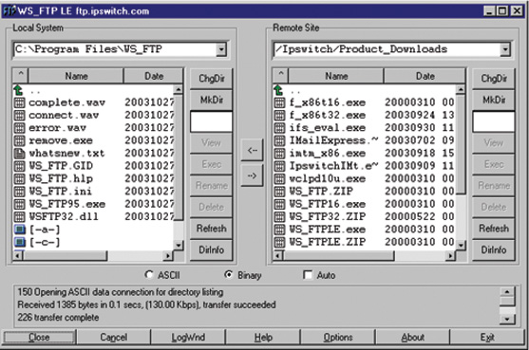
Other Internet Features
File Transfer Protocol (FTP)
  Copies files from a remote computer
  FTP client is needed
  Some sites require a password
Notes:
Teaching tip
Page 83 of the text has good pictures of ftp in action. This is a service students have most likely not encountered. Be sure to demonstrate in class.

Slide 9
Other Internet Features
Internet Relay Chat (IRC)
  Real time communication system
  Multi-users with many channels (rooms)
  Channels are dedicated to a topic
  All users can read the comments
Notes:
Discussion point
Have students discuss methods to be safe and secure in a chat room.

Slide 10
Other Internet Features
Instant messaging (IM)
  Private, real-time communication
  Message sent only to listed users
  Buddy lists contain IM names
Notes:
Insider information
Microsoft included Windows Messenger based on teen usage of computers. IM was one of the three most used computer programs among users under 16.

Slide 11
Other Internet Services
Online services
  Company that offers access by subscription
  Banks, games and research
  America Online offers content and Internet

Slide 12
Other Internet Services
Peer-to-peer (P2P) services
  User computers are connected together
  No centralized organization
  Users can communicate directly
  Users can share files

Slide 13
Chapter 2B
End of Chapter

